Slide 1
What is “phyloinformatics”?

Slide 4
Linking biodiversity data together

Slide 5
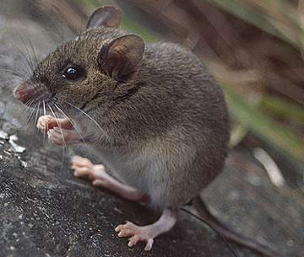
Apomys datae

Slide 6
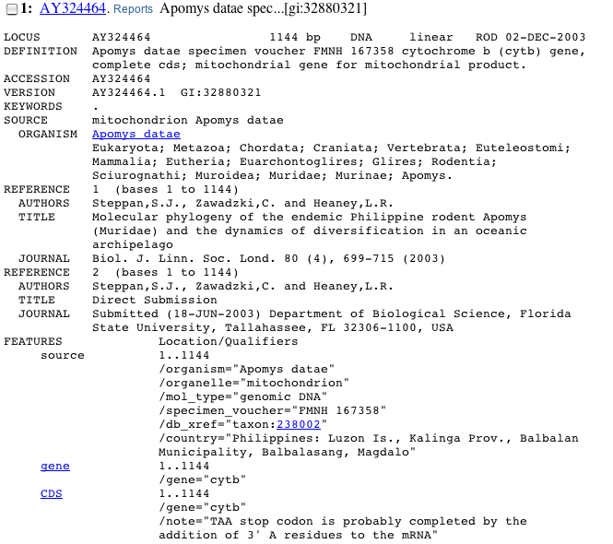

Slide 7
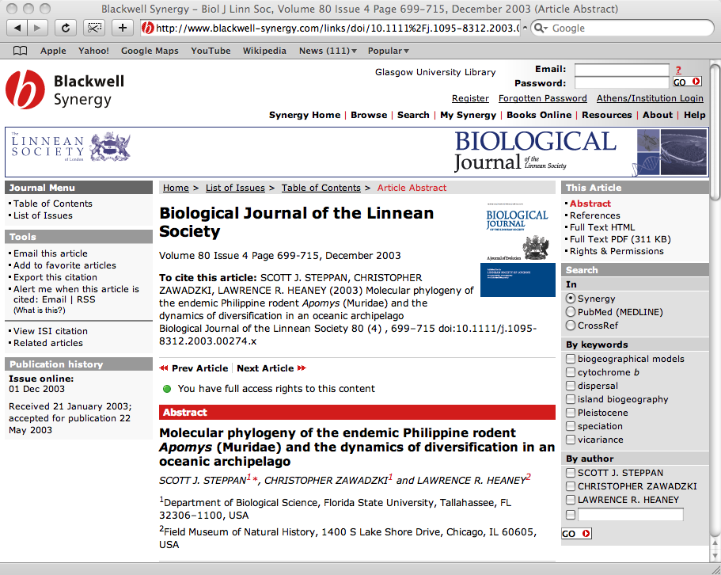

Slide 8
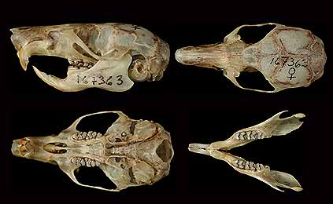
Apomys specimen

Slide 9
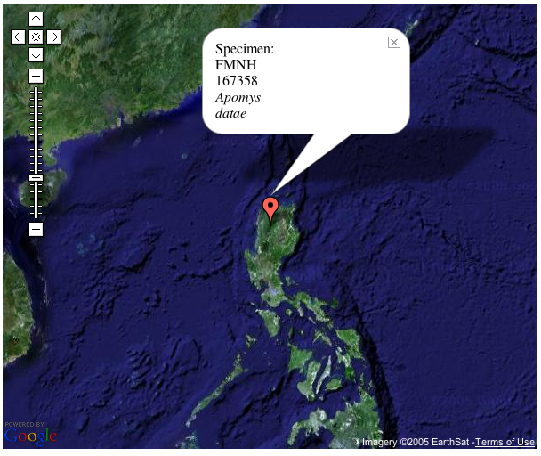

Slide 10
How do we integrate these data?

Slide 11
Why integrate?

Slide 12
Learn stuff we don’t know

Slide 13

There are known knowns, things we know that we know
There are known unknowns, things we now know we don’t know
But there are also unknown unknowns, things we do not know we don't know

Slide 14
Unknown knowns

Slide 15
Things we know …without knowing that we know

Slide 16
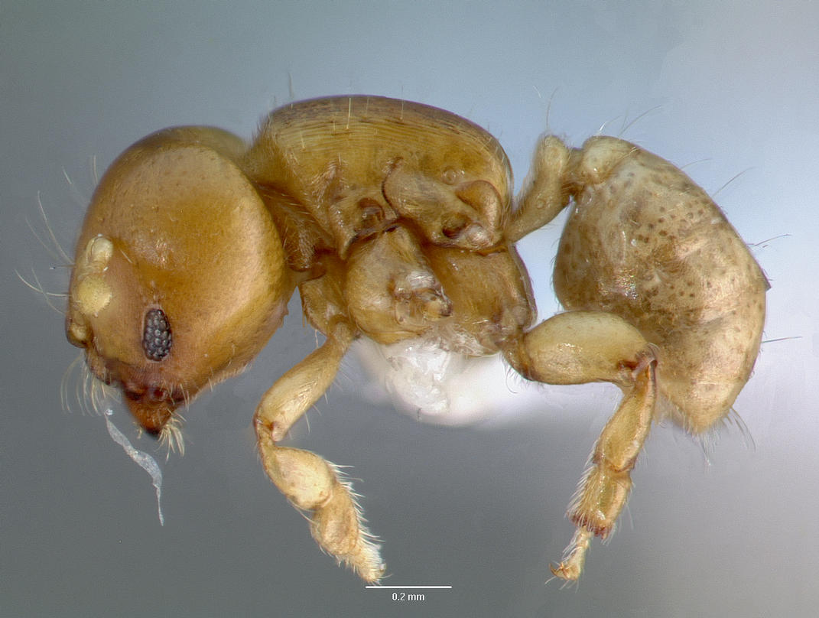
Melissotarsus insularis
Notes:
This ant illustrates a case where three different data source (NCBI, AntWeb, journal supplementary material) are needed to discover that, in fact, GenBank has sequences for this ant.

Slide 17


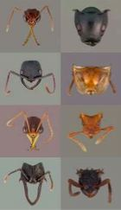
1
Melissotarsus insularis
no hit
Melissotarsus insularis
CASENT0107663-D01
CASENT0107663-D01
DQ176312
DQ176312
Melissotarsus sp. BLF m1
=
Melissotarsus sp. BLF m1
Melissotarsus insularis
Notes:
If you search NCBI for “Melissotarsus insularis” you find nothing. If you search AntWeb you find some specimens, one of which is CASENT0107663-D01. In the Phils Trans barcoding paper the supplementary material (also online in BoLD) shows that CASENT0107663-D01 has been sequenced, yielding a COI sequence with accession number DQ176312. If you go back to GenBank and look up the accession number you discover the taxon “Melissotarsus sp. BLF m1”, which must be the same as Melissotarsus insularis. Hence, GenBank should actually say “yes, I have information on Melissotarsus insularis”. There is latent knowledge in these data sources that we miss if they remain in ignorance of each other.

Slide 18
No one source has all the answers

Slide 19
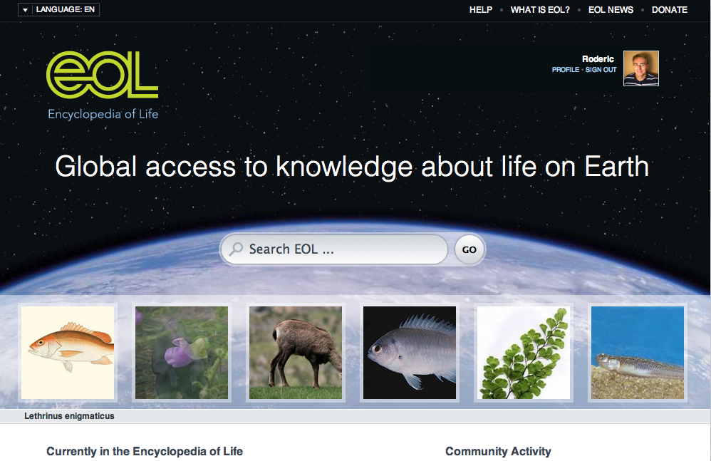
Notes:
http://www.eol.org

Slide 20


Slide 21
Single source

Slide 22
Many sources

Slide 23
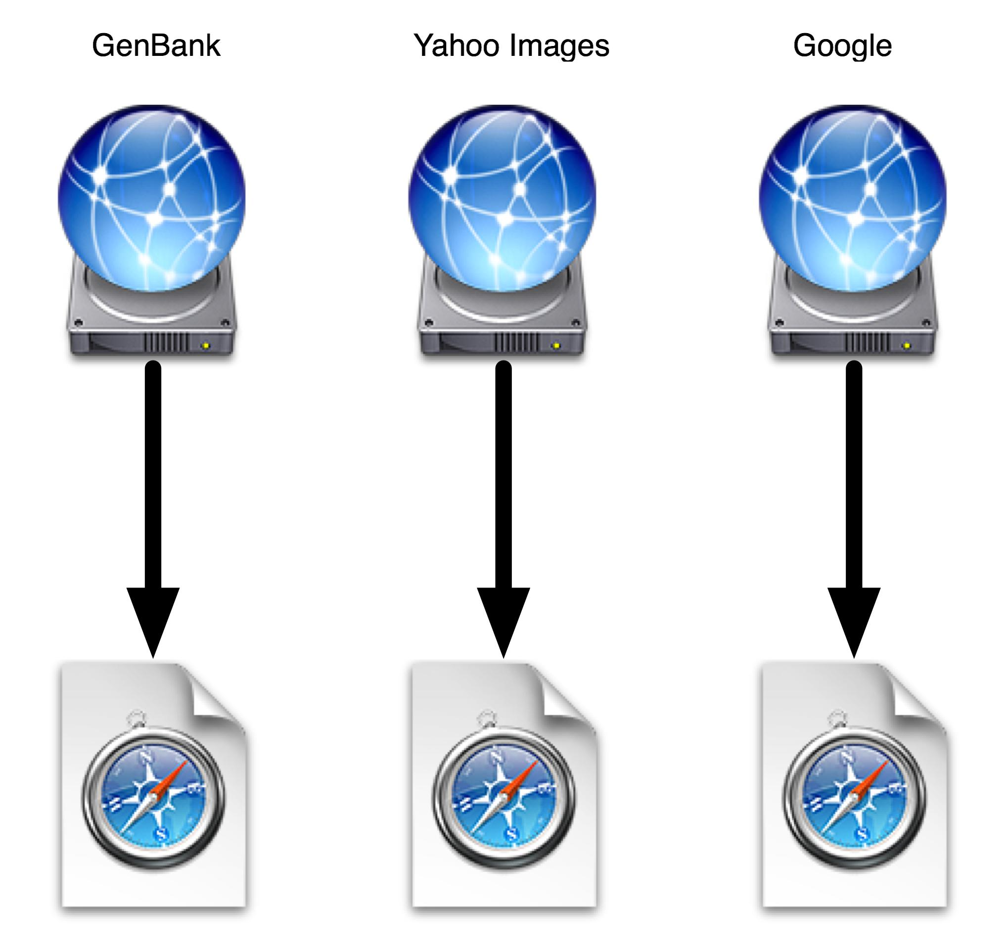

Slide 24
Combine sources

Slide 25
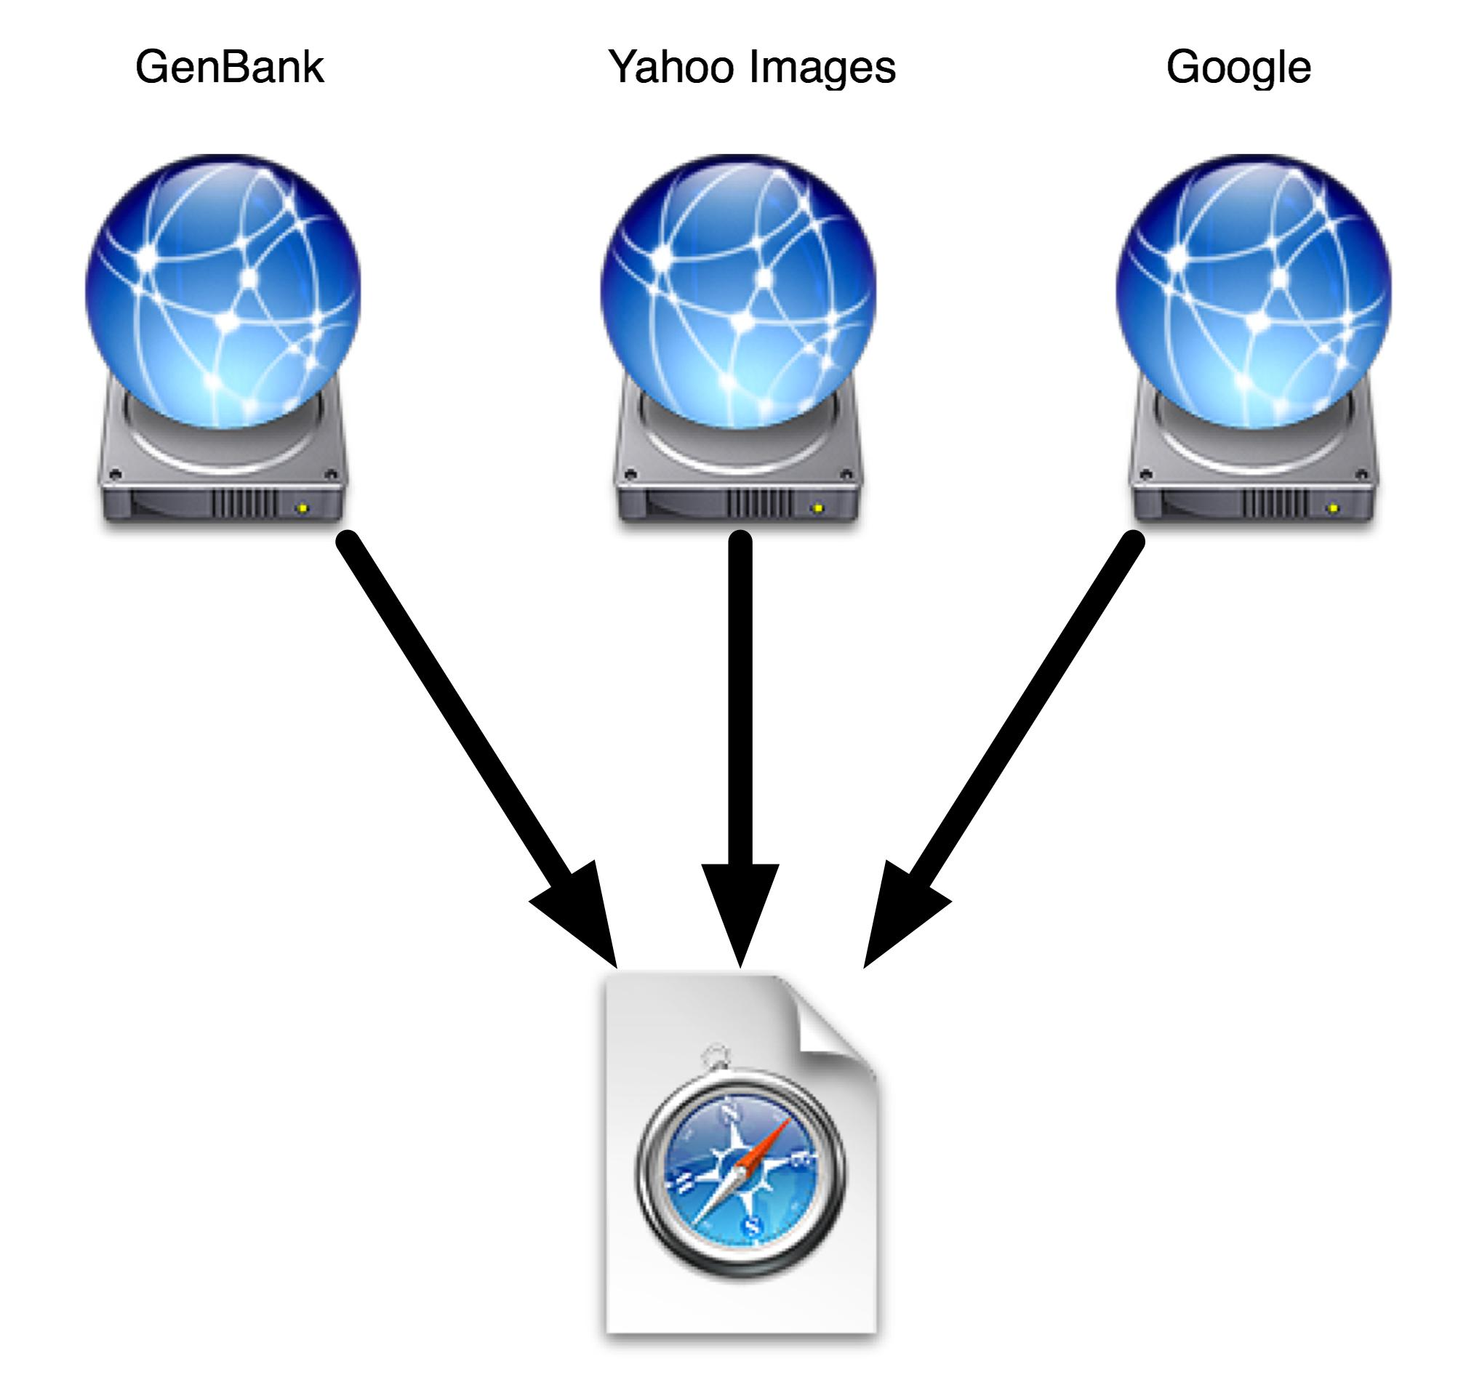

Slide 26
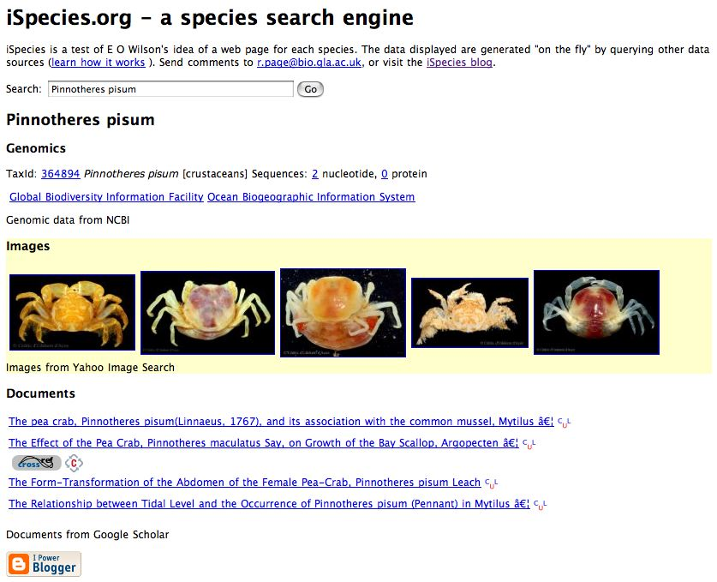
ispecies.org

Slide 27
Linking
Finding information about organisms
Linking together in “mashups”

Slide 28
Geography

Slide 29
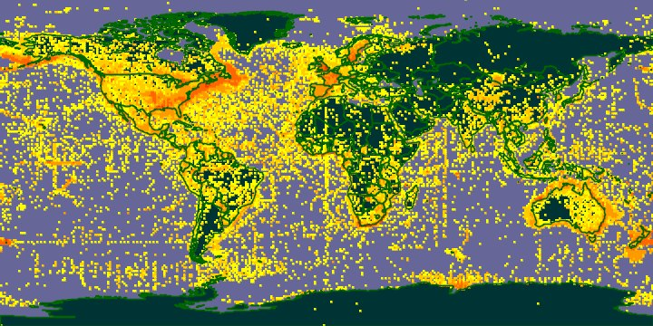

Slide 30

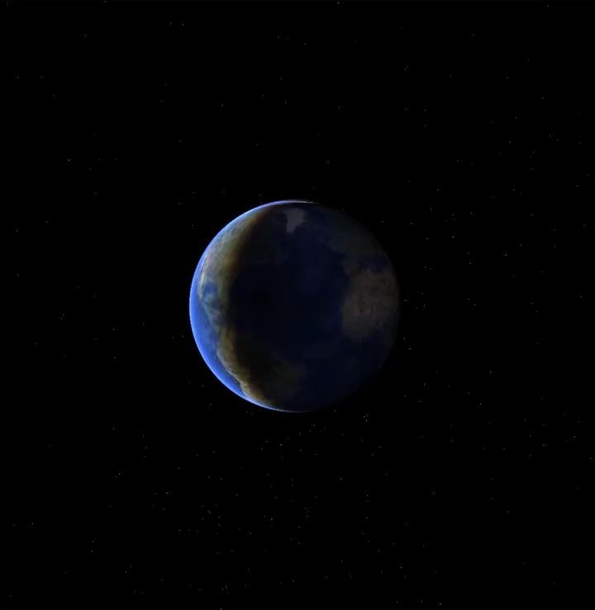
@rdmpage
Notes:
http://iphylo.blogspot.com/2007/06/earth-not-flat-official.html

Slide 31

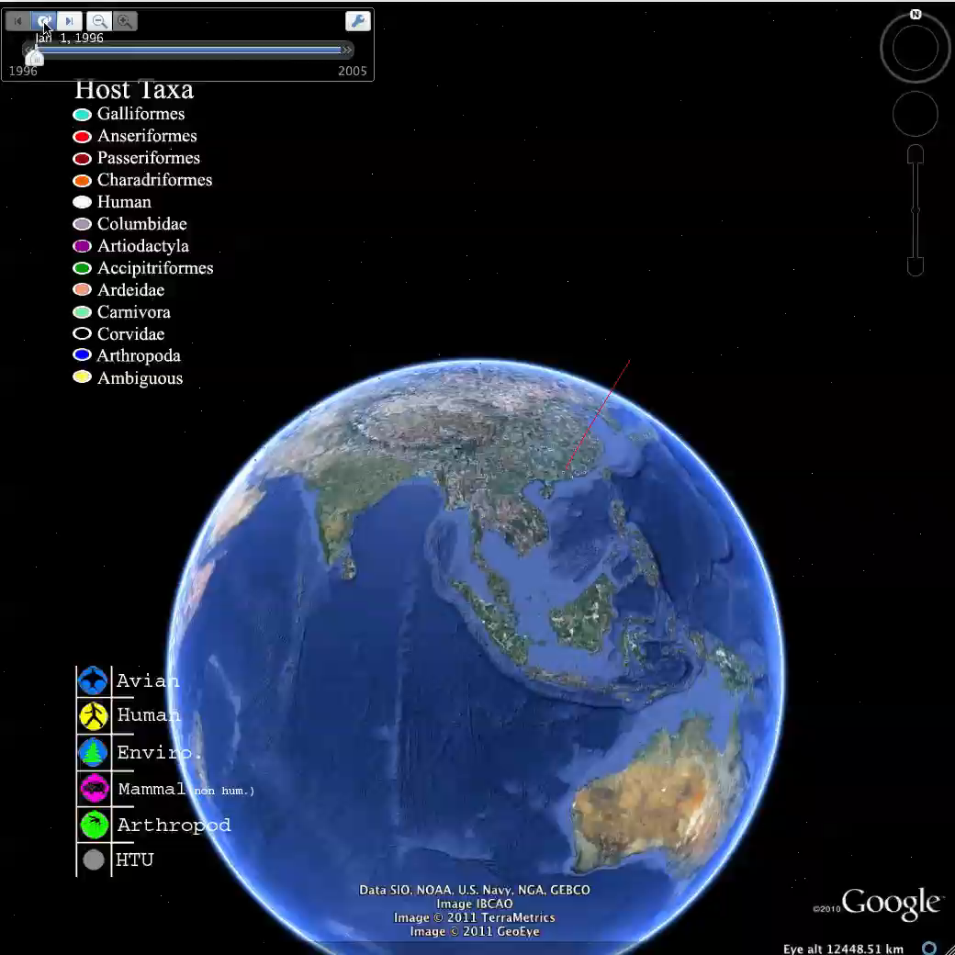
@andrewxhill
Notes:
http://systbio.org/?q=node/184, see http://dx.doi.org/10.1080/10635150701266848

Slide 32
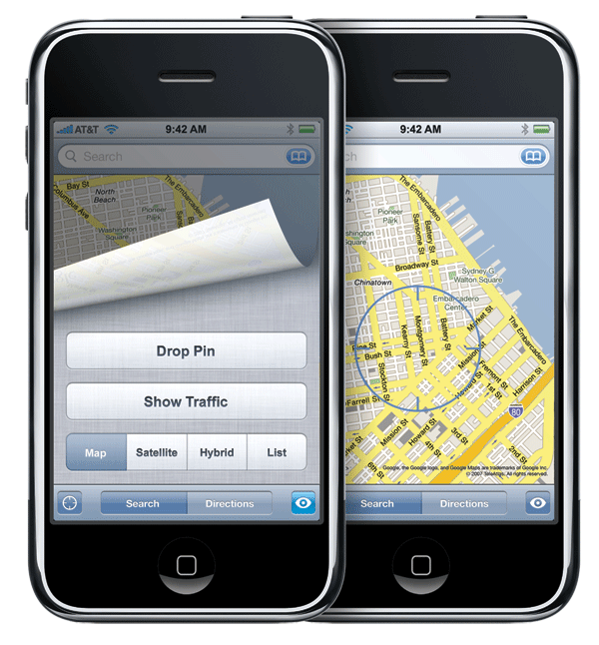

Slide 33
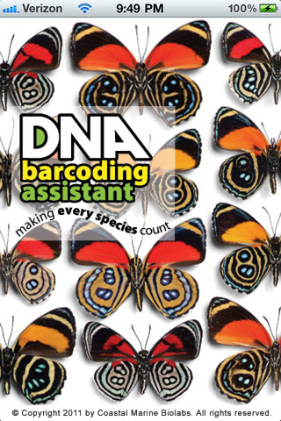
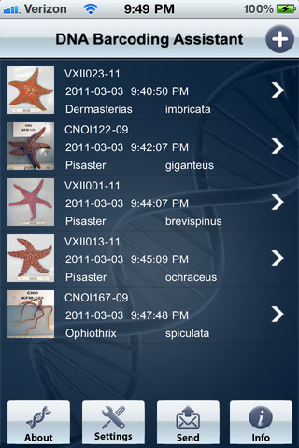

Slide 34
Geography
Species distributions
Geophylogenies

Slide 35
Taxonomy

Slide 36
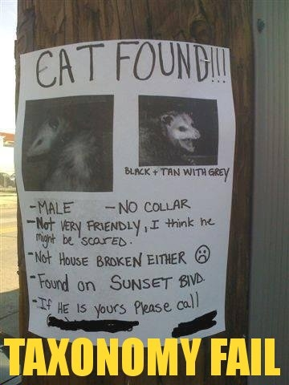

Slide 37
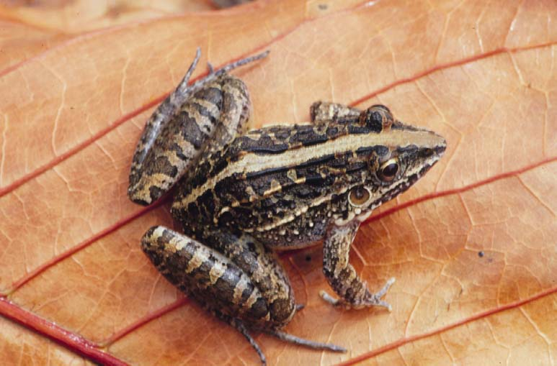
Names can change… Leptodactylus fuscus (Schneider)
Rana fusca Schneider
1802 Rana typhonia Sonnini & Latreille
1803 Rana typhonia Daudin
1824 Rana sibilatrix Wied
1826 Leptodactylus typhonius Fitzinger
1841 Cystignathus typhonius Dumeril & Bibron
1843 Leptodactylus typhonius Fitzinger
1858 Cystignathus fuscus Günther
1882 Leptodactylus typhonius Boulenger
1927 Leptodactylus sibilatrix Müller
1935 Leptodactylus sibilatrix Parker
1968 Leptodactylus fuscus Heyer

Slide 38
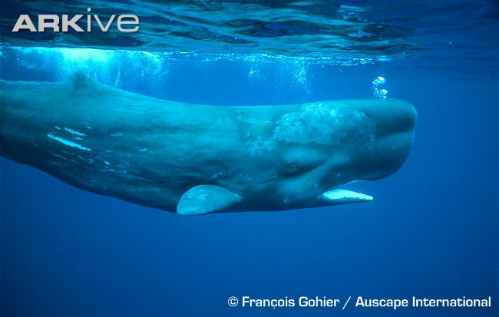

Slide 39
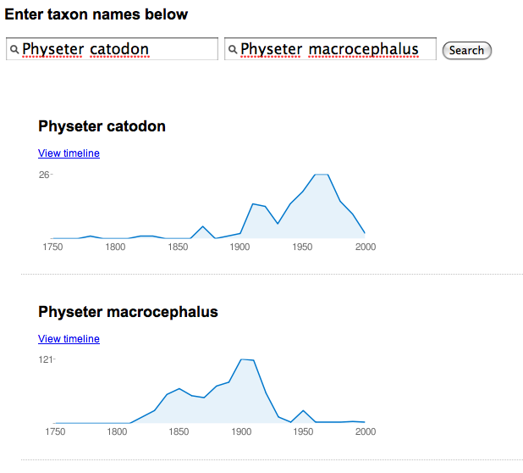

Slide 40
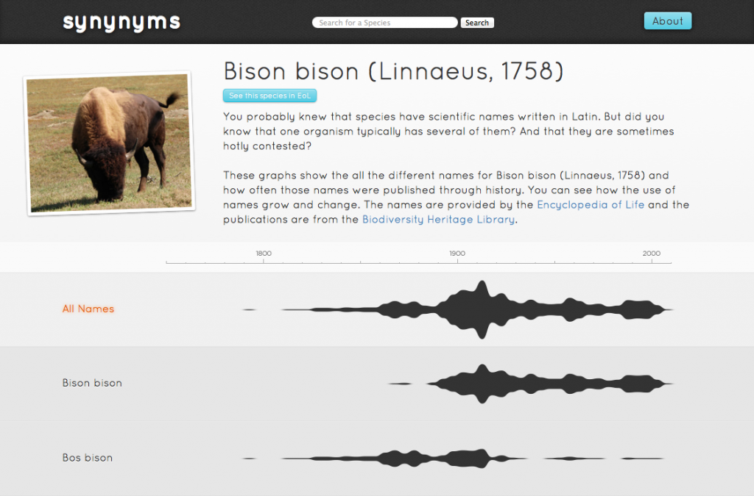

Slide 41

Taxonomy as a source of data

Slide 42
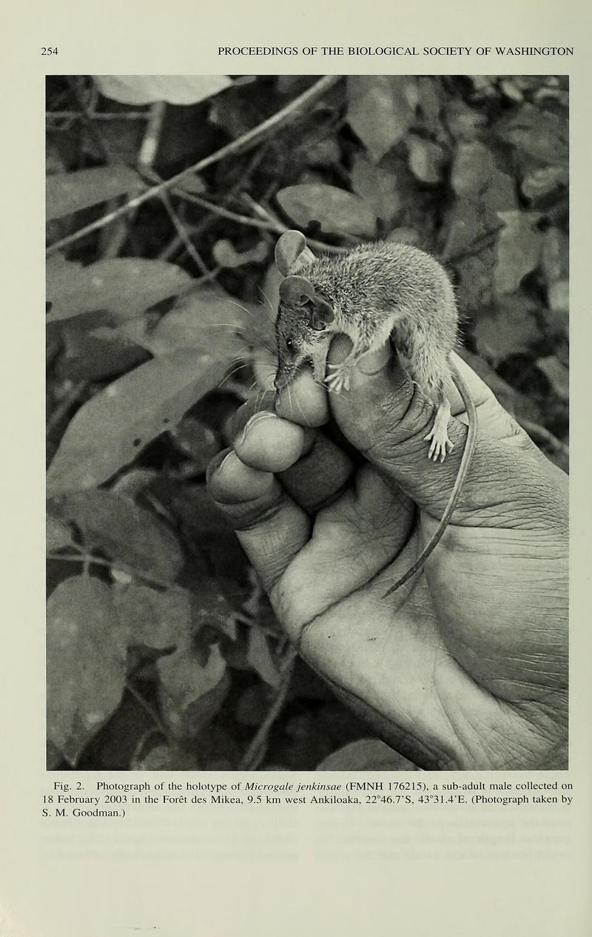

Slide 43
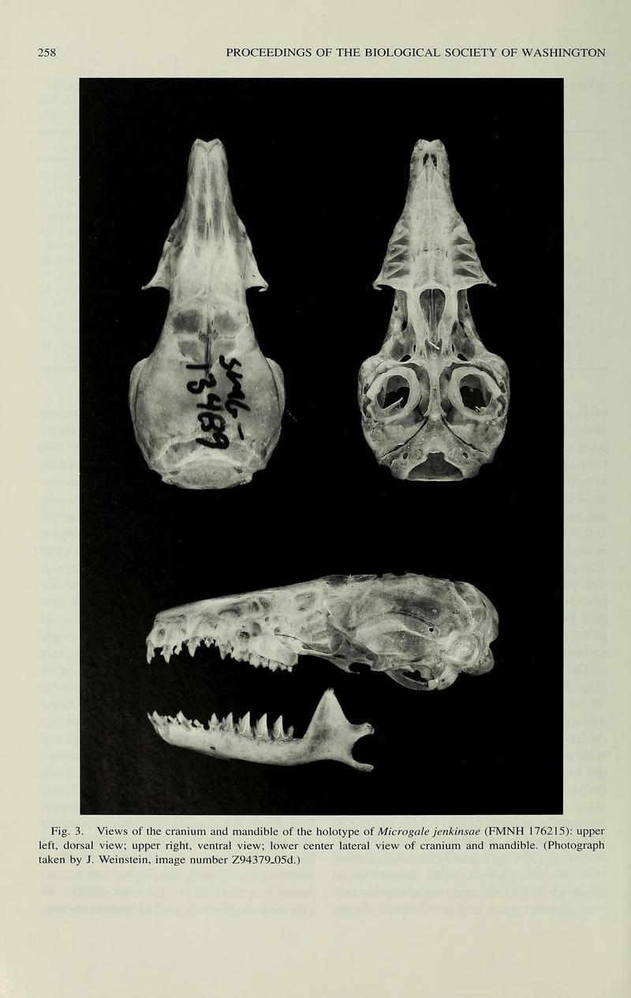

Slide 44
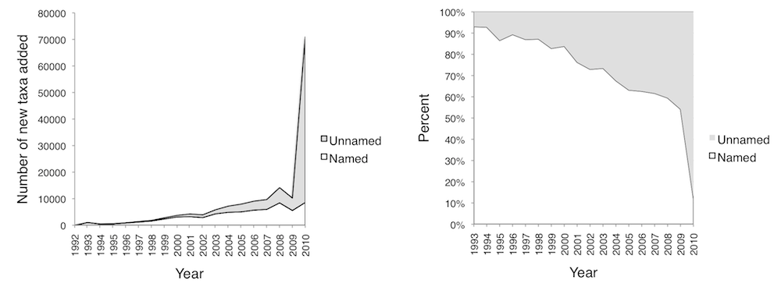
“Dark taxa”

Slide 45
Classification

Slide 46
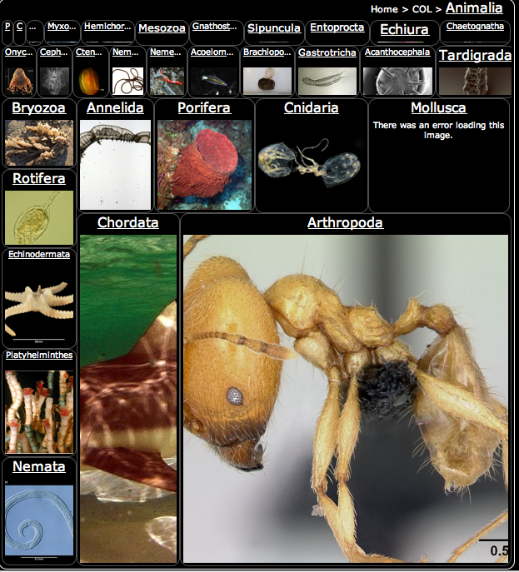
http://synthesis.eol.org/media/treemap/

Slide 47

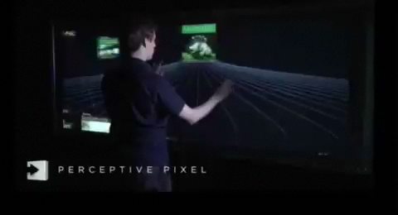
@kzelnio
Think how great of a tool that could be at museums
on a large flat screen at 4 year old height.
Notes:
http://www.perceptivepixel.com/ and http://iphylo.blogspot.com/2008/08/perceptive-pixel-taxonomy-demo.html

Slide 48
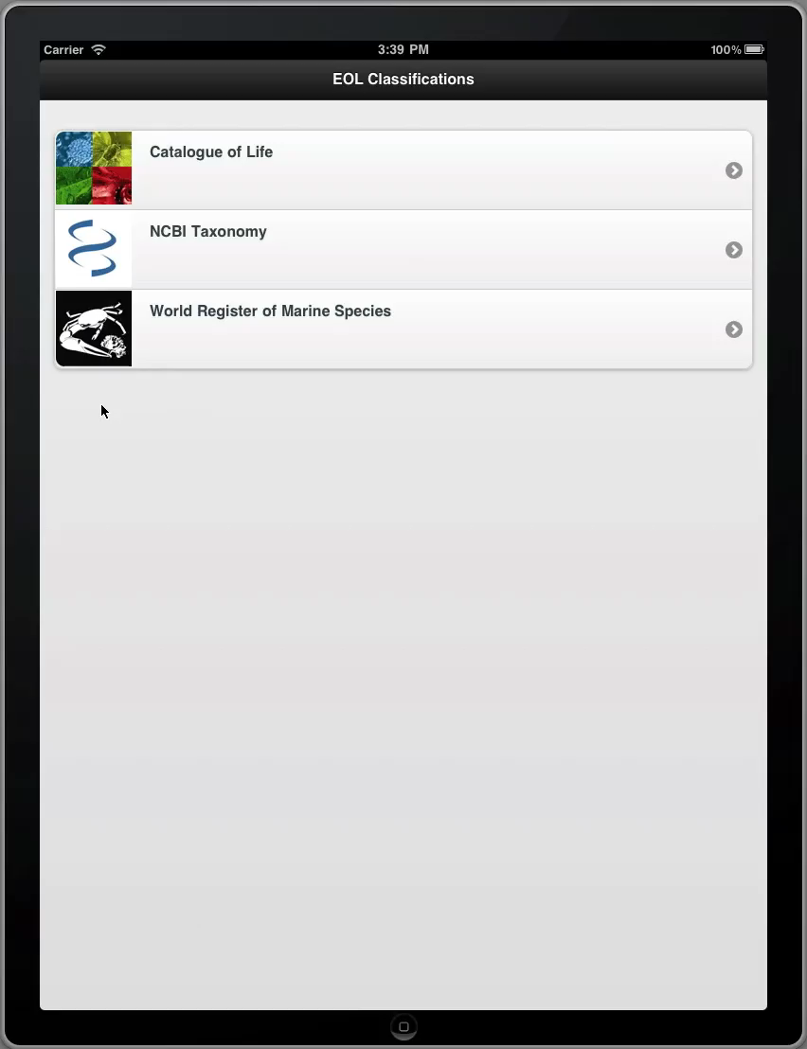

Slide 49
Taxonomy
Names
Synonyms
Classifications
Visualisation

Slide 50
Phylogeny

Slide 51
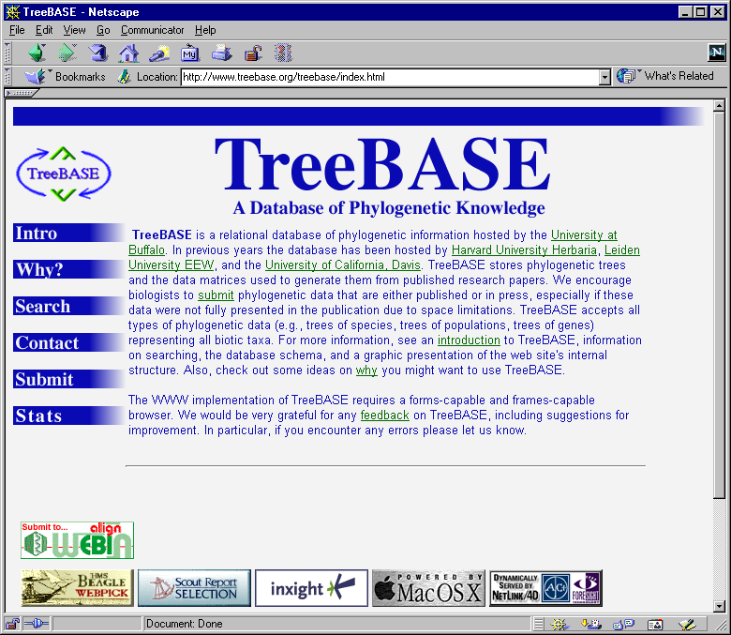

Slide 52
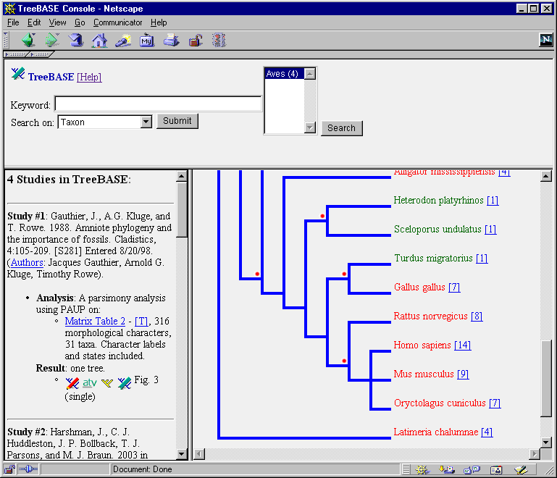
Rate of growth of phylogenetic knowledge
Number of papers with “molecular” and “phylogeny” in Web of Science
Number of studies in TreeBASE

Slide 53
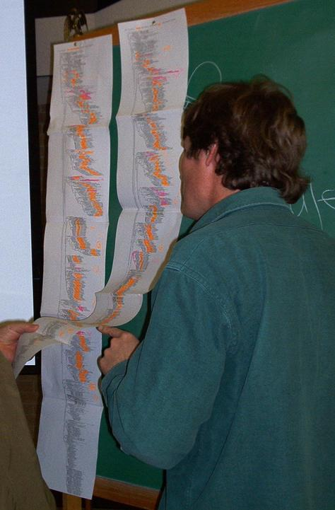

Slide 54
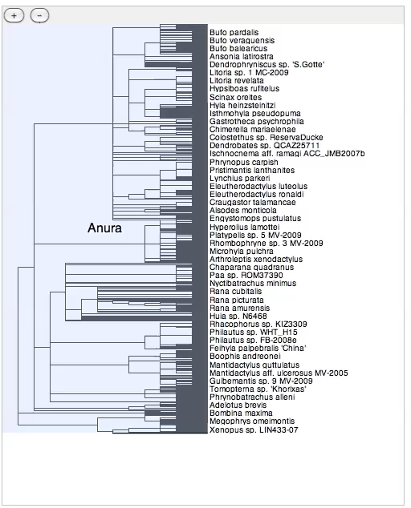

Slide 55

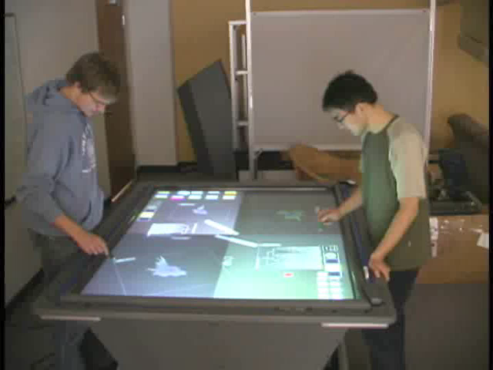
@dr_pi
Notes:
Petra Isenberg, see “Interactive tree comparison for co-located collaborative information visualization” http://www.ncbi.nlm.nih.gov/pubmed/17968069 and http://innovis.cpsc.ucalgary.ca/Research/CollaborativeTreeComparison

Slide 56
Phylogeny
Finding a phylogeny for a group of organisms
Displaying on the web (visualisation)

Slide 57
Data mining

Slide 58
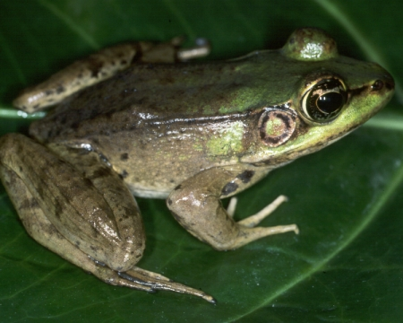

Slide 59
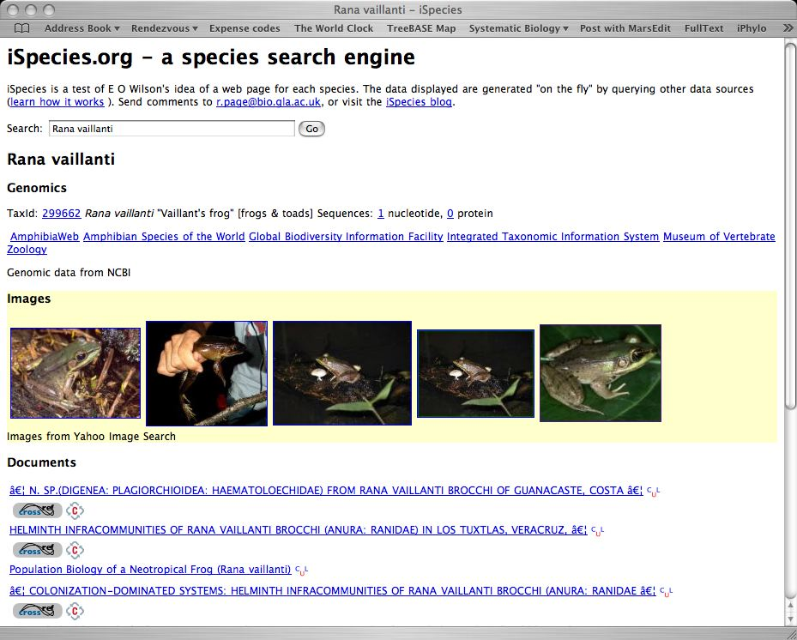
Text mining

Slide 60
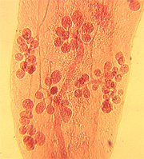
Morphological and molecular description of Haematoloechus meridionalis n. sp. (Digenea: Plagiorchioidea: Haematoloechidae) from Rana vaillanti brocchi of Guanacaste, Costa Rica
Halipegus eschi n. sp. (Digenea: Hemiuridae) in Rana vaillanti from Guanacaste Province, Costa Rica
Haematoloechus danbrooksi n. sp. (Digenea: Plagiorchioidea) from Rana vaillanti from Los Tuxtlas, Veracruz, Mexico

Slide 61
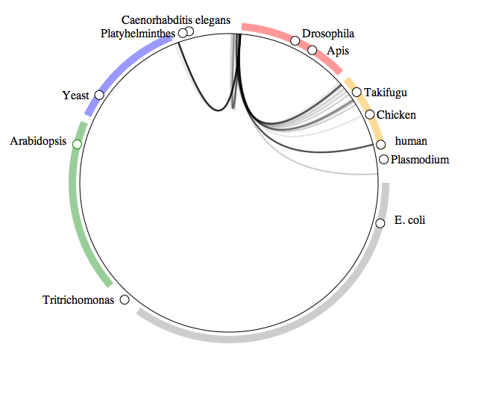
What do crustaceans live on?
Arthropods
Fungi
Vertebrates
Green
plants
Bacteria

Slide 62
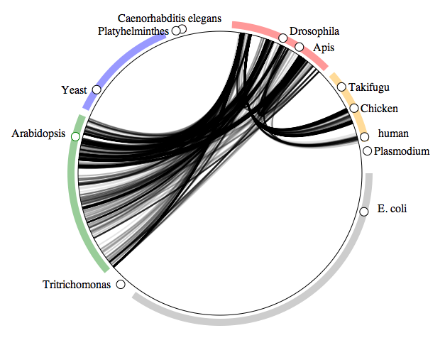
What do insects live on?
Arthropods
Fungi
Vertebrates
Green
plants
Bacteria

Slide 63
Data mining
Extracting information from the literature
Extracting information from databases

Slide 64
The End

